Slide 1
LonHand-remote control system solutions
Jinan LonHand Household Limited
June 6,2014

Slide 2
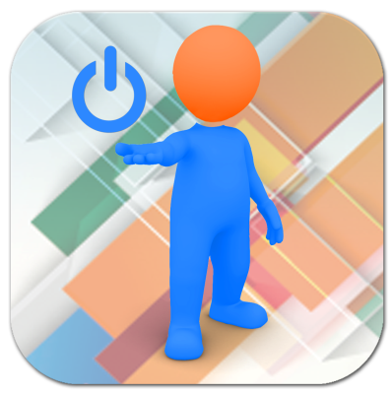
What is LonHand?
LonHand is a remote control system solution.
LonHand is a main business brand of Jinan LonHand Household Limited, which is a subsidiary company of Jinan USR IOT Technology Limited.
Brand image
Chinese name：zhangkongbao; English name：LonHand.
Both names are registered trademarks.

Slide 3
LonHand orientation
Be a shovel of The Nuggets Era; make clients successful; realize our value.
IOT: remote control and mobile platform control is a main trend. Companies of various fields want to amount to something in the trend.
LonHand will use its technology accumulation to serve those companies and become a solution supplier.

Slide 4
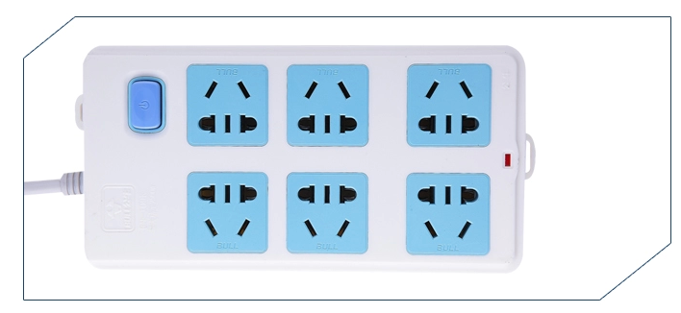
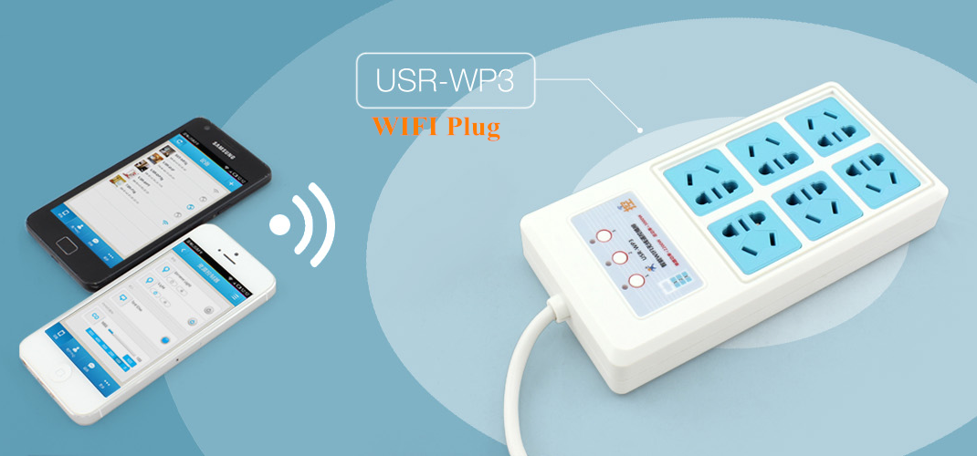
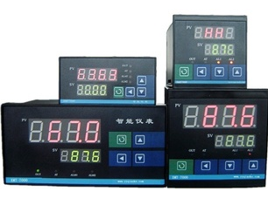
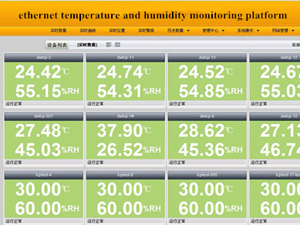
What can LonHand do？
control=》remote control; monitoring =》remote monitoring

Slide 5
LonHand system composition
Server
APP
Web
Embedded software
Embedded hardware

Slide 6
LonHand system framework
LonHand server
Ethernet
WIFI
GPRS
Router
WIFI AP
SIM card
APP Remote Control
GPRS Product：USR-RTU-411，USR-GPRS-PDU
APP Local Control
WIFI Product：USR-WP1，USR-WP3，USR-WM1
Wired Product：USR-IOT1，USR-IOT2
Devices of both control and controlled terminals can use the three networks for communication.

Slide 7
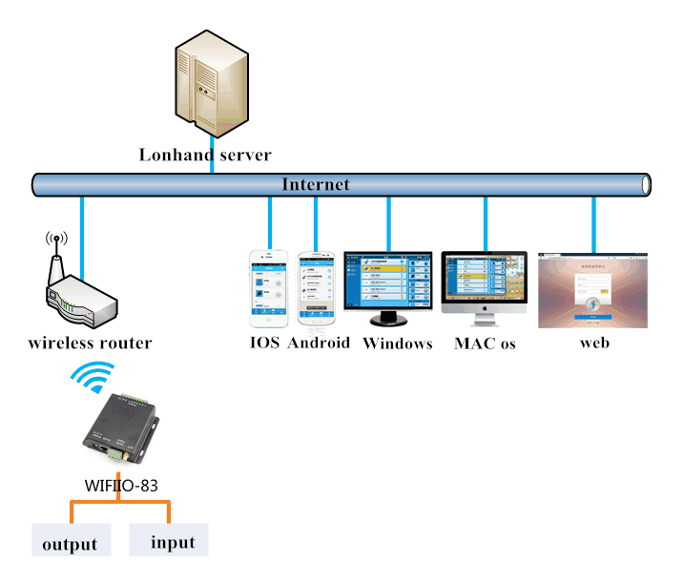
Typical application diagram

Slide 8
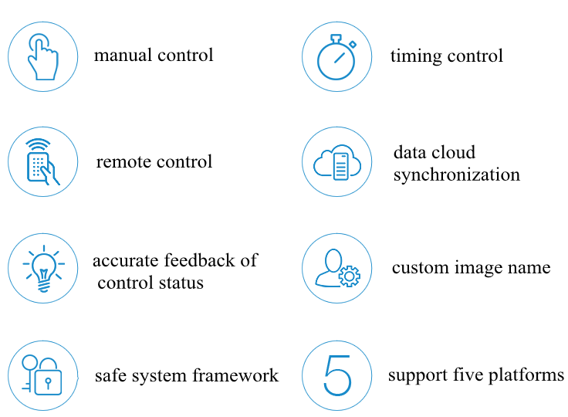
System advantages
Just one account; no port mapping and dynamic DNS.

Slide 9
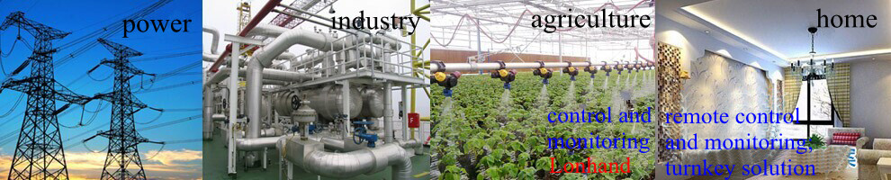
Specific applications
smart home
office energe saving
school automation
Agro-IOT control
smart LED program
remote printer program
solar energy controller
data monitoring system
smart door security system
smart switch program
industrial automatic control
smart samll appliance program
remote data acquisition program
remote temperature and humidity instruments

Slide 10
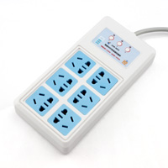
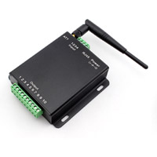
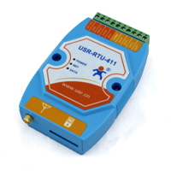
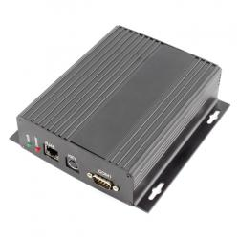
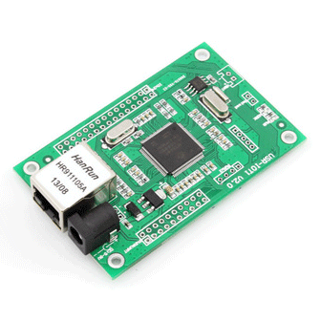
Existing product display
household WIFI plug
industrial WIFI controller
outdoor GPRS controller
wired ethernet controller
IOT control core

Slide 11
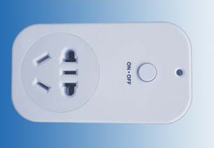
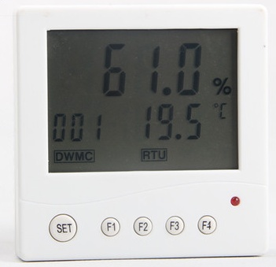
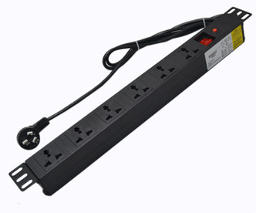
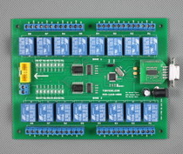
Developing products- in stability test
one way WIFI plug
household hygrometer
industrial GPRS PDU
16 channel network relay
WIFI LED dimmer and
one way WIFI relay module
are in development.

Slide 12
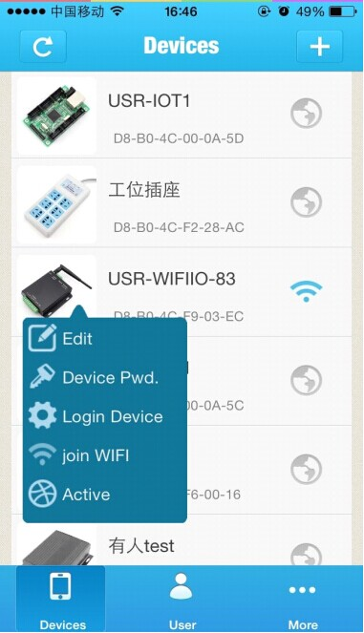
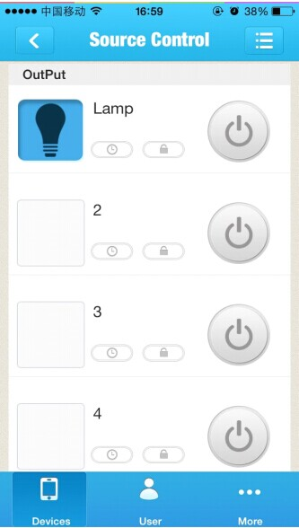
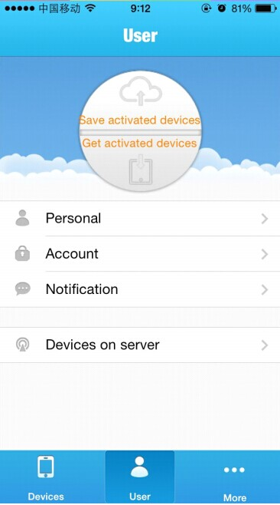
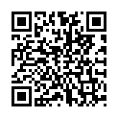

APP display-Iphone/Android version
IOS Version download
Android Version download

Slide 13
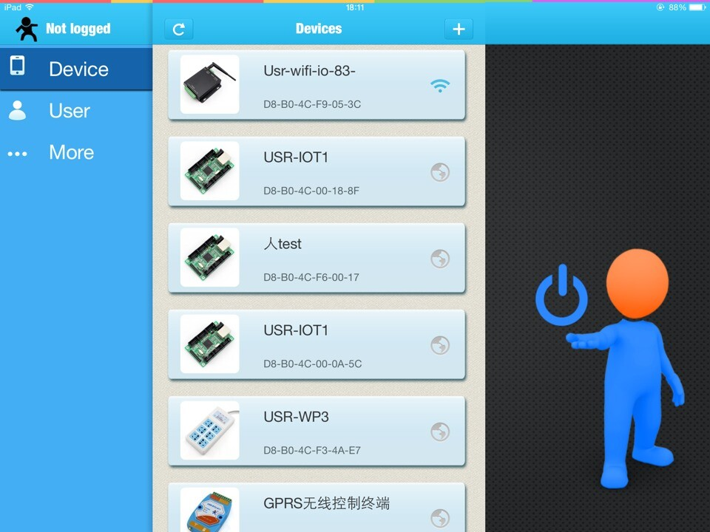
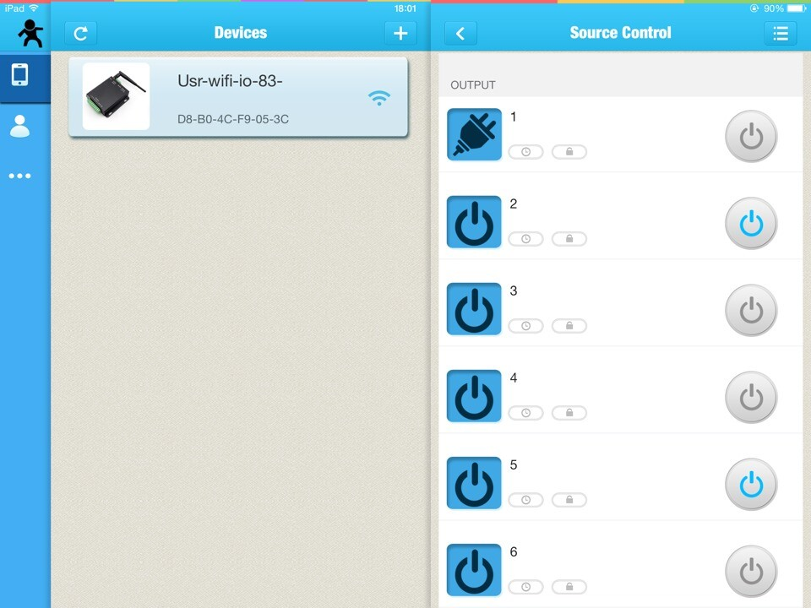
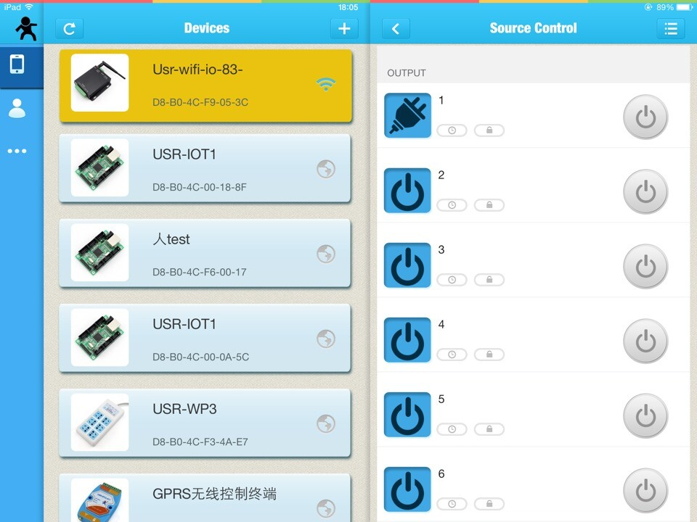
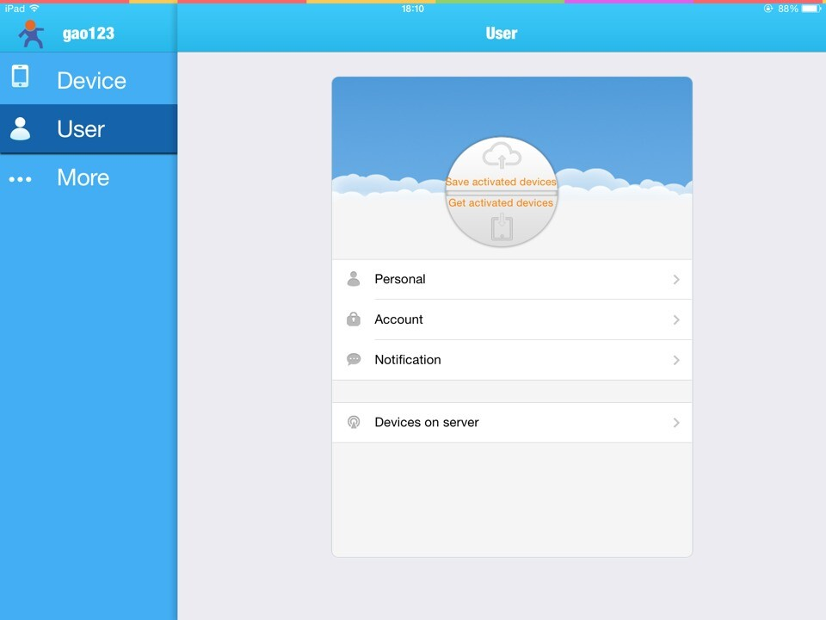
APP display-IPAD version

Slide 14
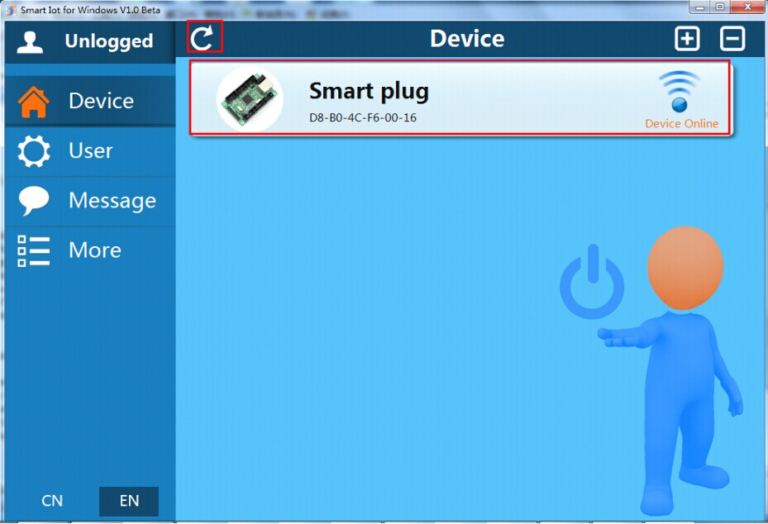
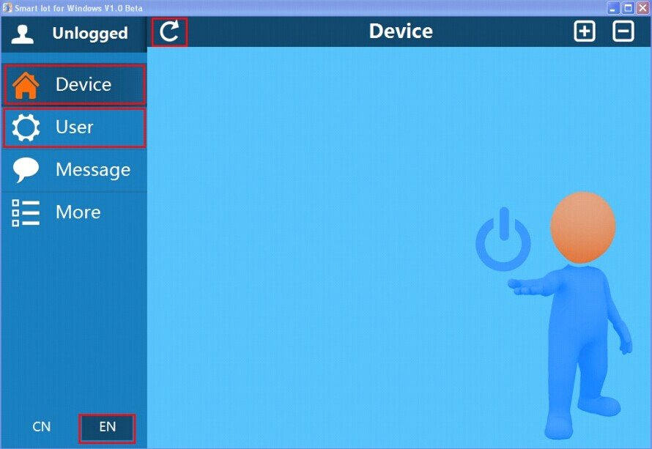
APP display-Windows/MAC version
Windows/ MAC OS

Slide 15

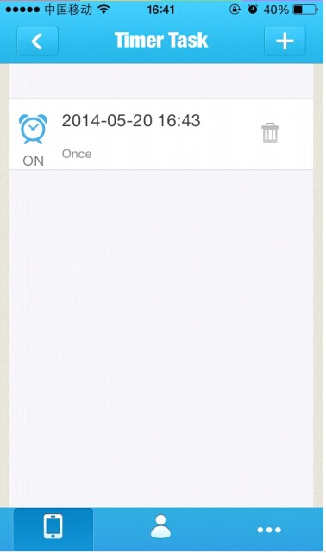
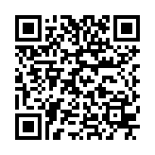
LonHand Mini
Some clients do not want to forward data through server. They just want to use data in the LAN. Or clients want to use Dynamic DNS and port mapping to perform remote control by themselves. Therefore, we launched a simplified version of LonHand: LonHand Mini.
LonHand Mini supports IOS, Android, Windows and Mac.

Slide 16
Client cooperation ways
1、complete OEM solutions.
2、secondary development software.
3、secondary development hardware.
4、APP customization development.
5、software and hardware system customization.
We turn traditional control to remote control by mobile devices, which enhances competitiveness of traditional control equipment.
We will cooperate with traditional equipment suppliers to conspire development.

Slide 17
Difficulty level and workload
complete customization solution
Five
APP customization development
Four
secondary development hardware
Three
secondary development software
Two
complete OEM solution
One

Slide 18
Cooperation way-one:complete OEM solution
Clients use and sell products; Our company deals with all the rest matters.
Manufactureing software and hardware with clients'logo, setting up a server and supplying product will be completed by our company.
Create client's own brand.
Clients are responsible for promoting and marketing. Clients'first purchase payment should be no less than $20,000. Or clients pay solution using fee worth $5,000.
We will not modify any software and hardware functions; we just modify brand message and contact information. We do not provide source code; we just provide APP.

Slide 19
Cooperation way-two: secondary development software
Clients are required to purchase our hardware and write APP themselves according to our communication protocol. LonHand server is not required.
Our company provides:
  complete communication protocol document and interface specification.
  dll library files of Windows.
  communication encapsulation library of Android.
  communication encapsulation library of IOS.
Source code of LonHand Mini can be sold at $2000 or provided free to major clients.Our payment way is that clients pay first and then get a discount on purchase payment.

Slide 20
Strength and weakness analysis
Strength: easy operation;our engagement not required; autonomous control and upgrade maintenance; high flexibility.
Server data forwarding not required; maintenance and management not required; convenient selling.
Weakness: if clients want to realize remote control,traditional port mapping and Dynamic DNS are required.
Clients can only find hardware suitable for their applications from our existing products.

Slide 21
Cooperation way-three:secondary development hardware
If our existing type and quantity of hardware source can not meet clients'need, or if appearance and encapsulation of products can not meet their requirements, they can design the underlying hardware by themselves according to our LonHand Protocol.
Our company provides:
  communication module supporting LonHand: modules of Ethernet, WIFI and GPRS.
  communication protocol: serial port communication protocol between SCM and communication module.
  SCM with LonHand control protocol: $3~5 per piece.
We charge $2000 for technical support of SCM software and protocol interfaces.And we can provide major client technical support for free.Our payment way is that clients pay first and then get a discount on purchase payment.

Slide 22
Cooperation way-four：APP development
Our APP is of customizability and of no industry characteristics.We can provide customized APP service for clients according to various industries.
Charging standard: over $2000 for each platform APP; for simple function interface customization, we can offer a discount.

Slide 23
cooperation way-five: software and hardware system customization
If LonHand framework can not meet clients'need, our company can integrate our development source to provide complete customization for clients as long as the customization belongs to the field of remote monitoring and control.
Charging standard: over $ 5000

Slide 24
Successful cases
Hygrothermograph:secondary development software,remote observation and record.
Humidfier: fully customized project, remote control,automatic control.
Aquarium controller: secondary development hardware,remote observation and control.
Industrial GPRS PDU Plug：secondary development hardware,remote control.
Real-time monitoring of ships: secondary development APP software,remote monitoring, real-time alerts, prevention of water,fire and theft.
Construction tower crane monitoring: operating parameter monitoring and alarm,directional lock machine.
Monitoring and control of wine storage devices:temperature and weight monitoring; if stock is inadequate, delivery center can make delivery arrangement.

Slide 25

Expect cooperation with you
If you want to cooperate with us, please contact us.
Our proposal engineering will write specific project details and recommend the most suitable cooperation way according to your project status.
We would like to grow together with our clients!

Slide 26
Contact information
General manager：13864129404 Mr. Gu
Sales manager：15253163268 Mr. Hou
LonHand manager：18675583695 Mr. Shao
Shenzhen office：18665818916 Mr. Zhou
www.zhankongbao.com ; www.zkb.io
Room 724-729,North Tower, Huizhan Guoji Cheng, High-Tech Zone, Jinan.

